Slide 1

Song Recommender
Project by Guiherme, Julia and Rafael

Slide 2
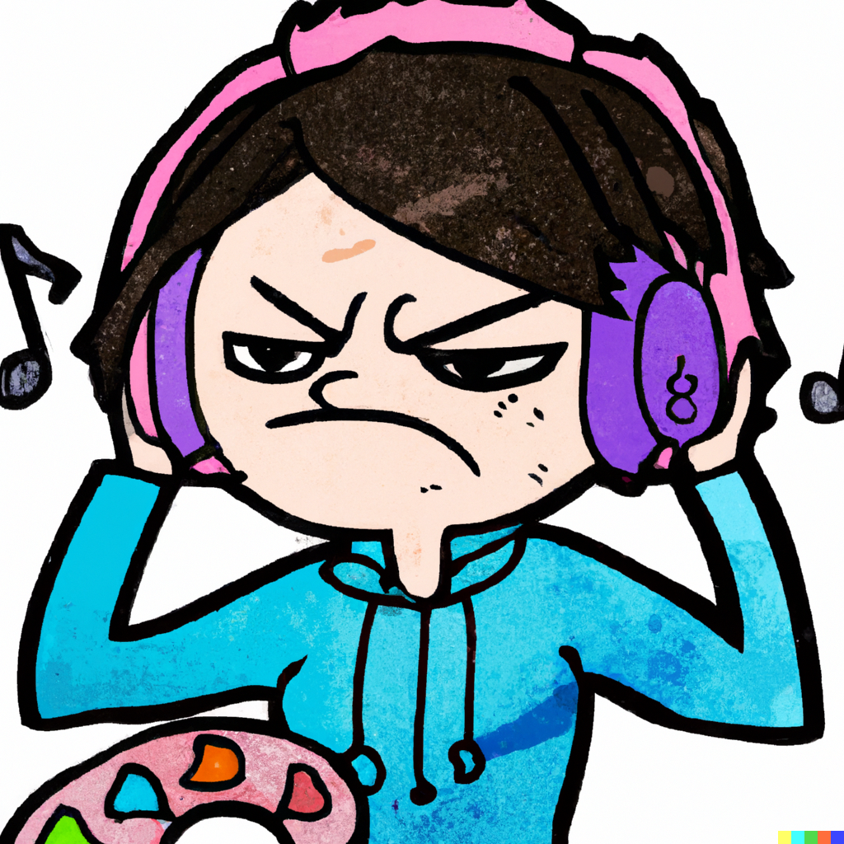
What a bummer to wake up on a Monday morning just to find out that your daily mix is a total disaster?

Slide 3
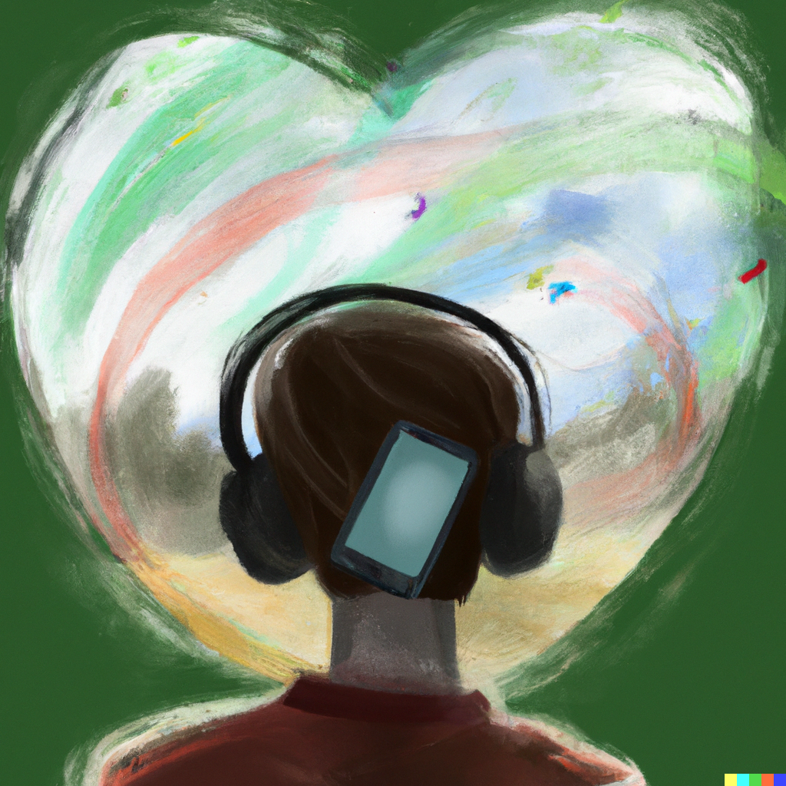
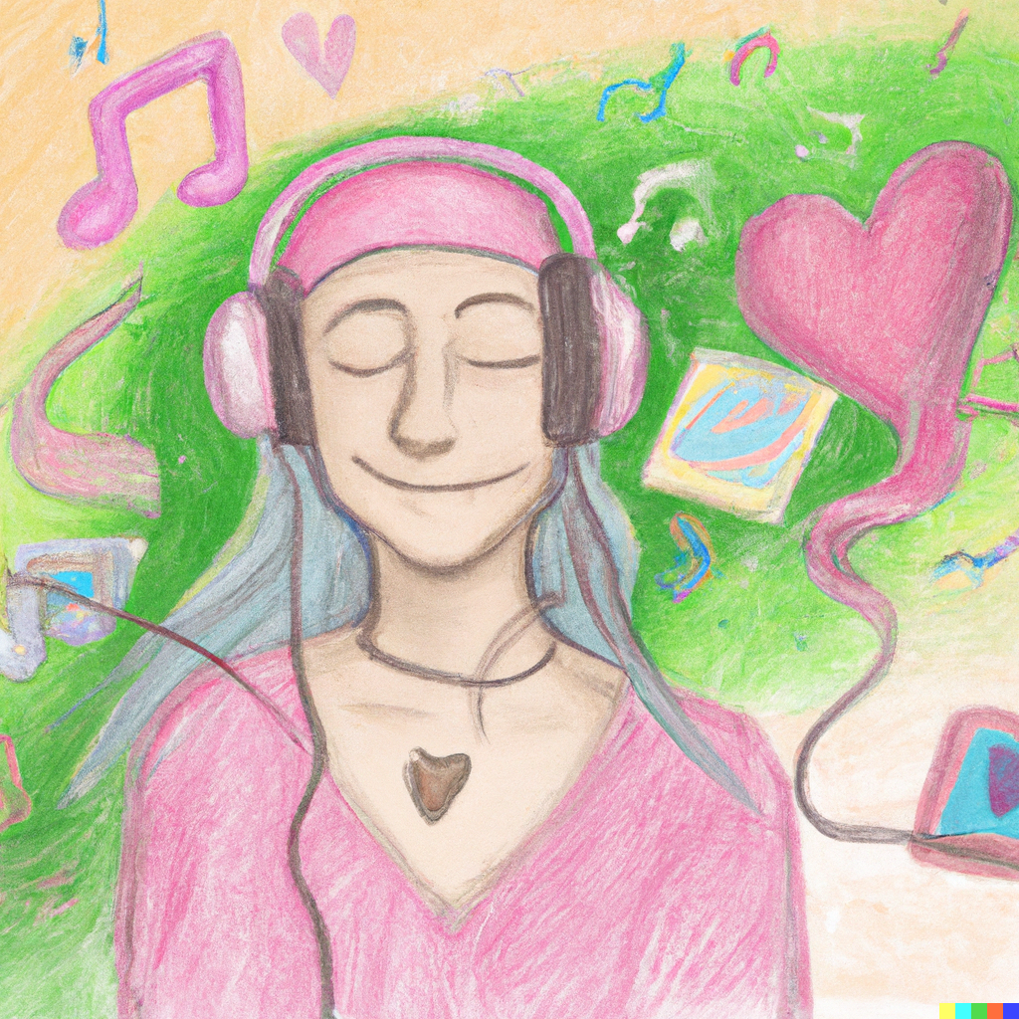
Try out our Song recommender, it is going to make your day! ☺

Slide 4
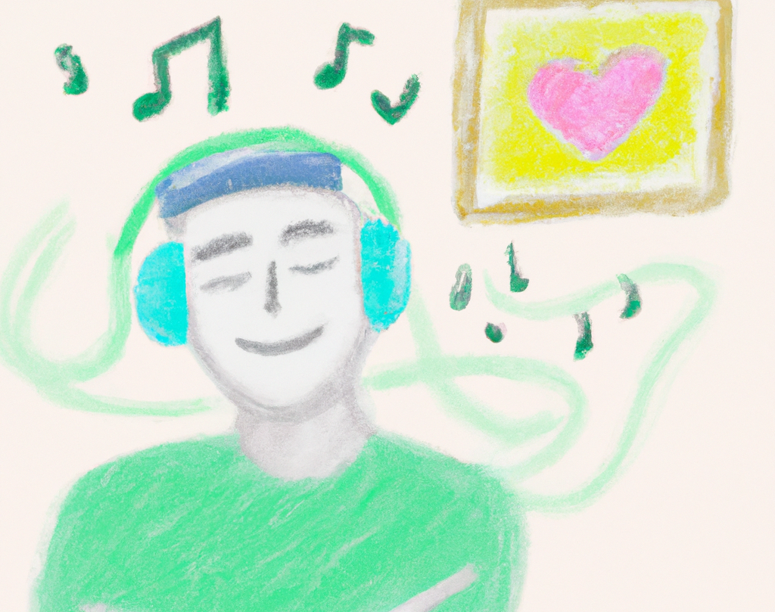
Just try it!
All you need to do is search for one song
and it will give you the next one
And the next one
And the next one
and you gonna love them all!

Slide 5

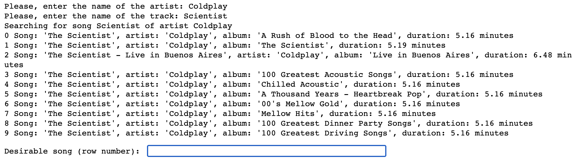
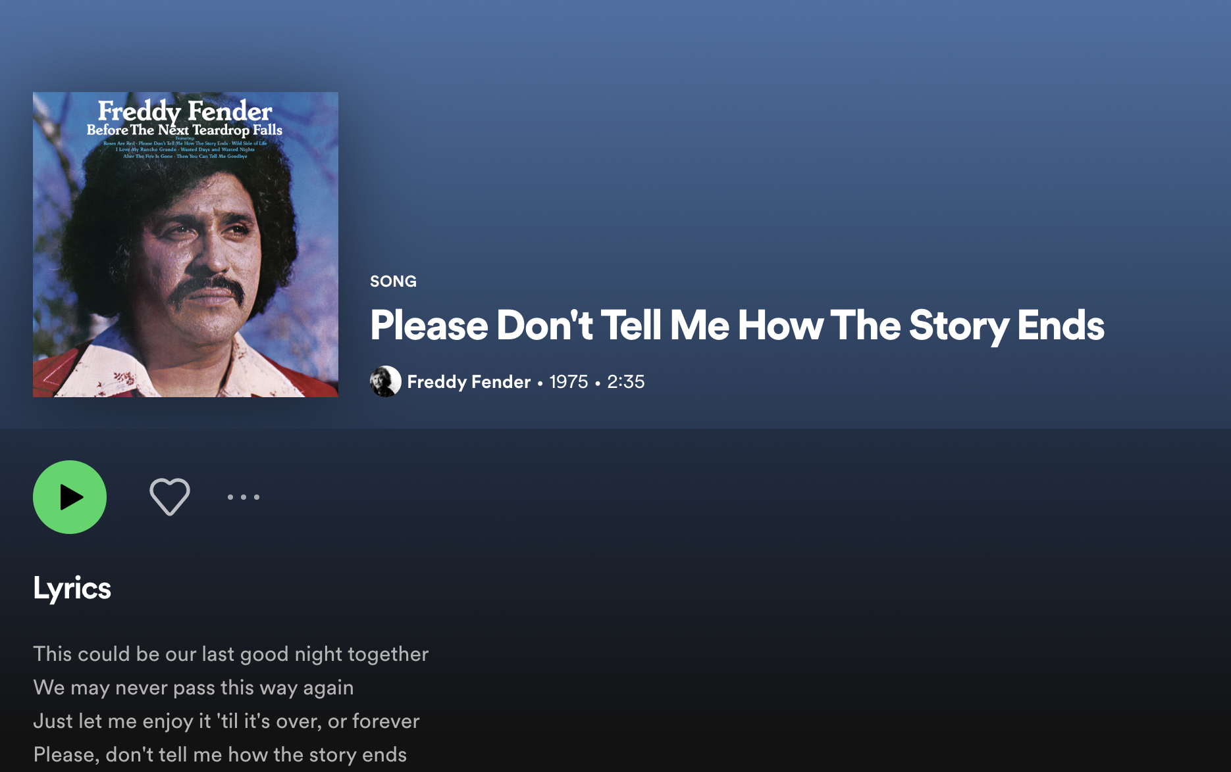

Demo

Slide 6
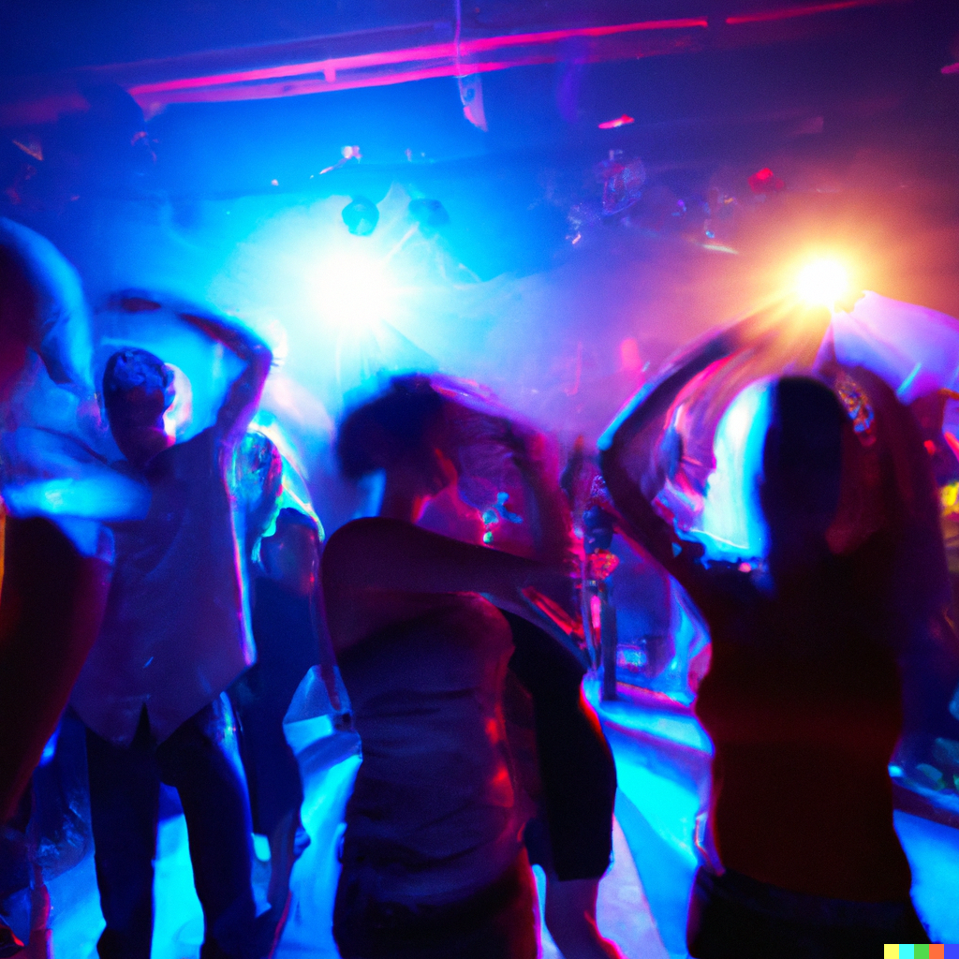
ENJOY IT! Thank you for your attention :)

